Slide 1
CSE 3110 Database Systems Lab

Slide 2
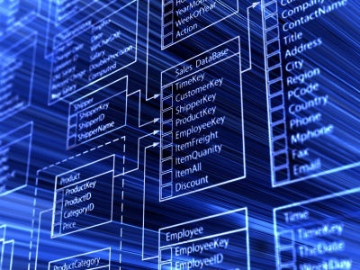
Your First Database Lab ☺

Slide 3
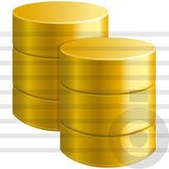
What is DataBase???
What name suggest…
Data + Base= Database
Data means raw information
Base means holding place/storage area
Database is a store house of raw information. So simple ☺

Slide 4

So why database to study?
Database allows manage your information in a organized and secure way.

Slide 5
Database is abstract concept. So what implements database??
It’s Database Management Systems (DBMS)
A software tool that implement the concept of database.

Slide 6

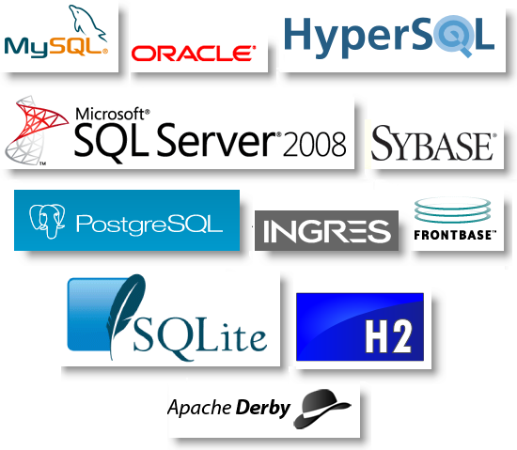


What are the popular DBMS available till now??
DB2
MySQL
Oracle
PostgreSQL
SQLite
SQL Server
Sybase

Slide 7

So which one is our Choice??
It is none other than the one and only Mr.Oracle
Oracle is someone legendary who foresee the future.

Slide 8

so Why Oracle???
world’s top 10 banks run Oracle applications
Efficient recovery from human errors .
Faster database recovery
Atomicity
Consistency
Isolation
Durability

Slide 9
Some Terminologies
User
Schema
DBA
Table
Row
Column
Field
Record
SQL
Query
etc

Slide 10
Let us Start with the Oracle
Installation
User Creation
Granting privileges
Creating table
Inserting data into table
View Table descriptions
View table data
Etc.

Slide 11
Thank You

